Slide 1
national technology day
Former Prime Minister Atal Bihari Vajpayee designated May 11 as National Technology Day in India to commemorate the historic Pokhran nuclear tests conducted by the Indian Army in Rajasthan in 1998. The following year, on May 11, 1999, the Council for Technology organised the inaugural celebration of National Technology Day.

Slide 2

Browse Getty Images’ premium collection of high-quality, authentic National Technology Day stock photos, royalty-free images, and pictures. National Technology Day stock photos are available in a variety of sizes and formats to fit your needs.

Slide 3
National Technology Day will be celebrated on May 11, 2024 which will fall on Saturday. Every year a theme for the event is decided by the Technology Development Board (TDB).
The theme for this year's event is “School to Startups-Igniting Young Minds to Innovate”. The theme for National Technology Day this year is aimed at inspiring young minds to innovate, get them towards the path of a opening a startup while also undersstanding the remarkable scientific achivements of the country.
National Technology Day: History and significance
As part of “Operation Shakti”, India successfully conducted the Nuclear Missile Test at the Indian Army's Pokhran range on May 11, 1998. The successful testing in Pokhran made India only the sixth country in the world to possess nuclear weapons.
The government under Prime Minister Atal Bihari Vajpayee directed the Council for Technology to conduct the National Technology Day celebrations on May 11 from next year. Since then, the event has been an annual affair aimed at highliting India's quest for scientific inquiry, technological creativity and innovation.
The central government also uses the platform to announce the winners for Rashtriya Vigyan Purashkar, or National Science Awards. Meanwhile, to mark India's technological prowress, several seminars, conferences and exhibitions are conducted across the country

Slide 4
Why is National Technology Day celebrated on May 11?
On the same day, they also tested their first indigenous aircraft, Hansa-3, and conducted a successful test firing of the Trishul missile. The Prime Minister at the time, Atal Bihari Vajpayee, declared May 11 as a day of significant achievement for the country, and National Technology Day was observed for the first time on May 11, 1999.
The Prime Minister at the time, Atal Bihari Vajpayee, declared May 11 as a day of significant achievement for the country, and National Technology Day was observed for the first time on May 11, 1999. Since then, the Technology Development Board has been honoring scientists and engineers and their technological innovations that have added to the growth of India.

Slide 5


We can all agree that technological advancements have been some of mankind’s greatest achievements. It has definitely made our lives easier, more efficient, and more productive, and we are always thankful for that.
The people of India showed their thanks when they declared May 11 as National Technology Day in 1999, following their grand achievements in the field on that day, the previous year.
On May 11, 1998, the country conducted three successful nuclear tests at the Indian Army’s Pokhran Test Range under Operation Shakti. Two more nuclear tests were conducted on May 13, led by late President Dr. A.P.J. Abdul Kalam, which made India an official member of the elite club of nuclear power nations.

Slide 6
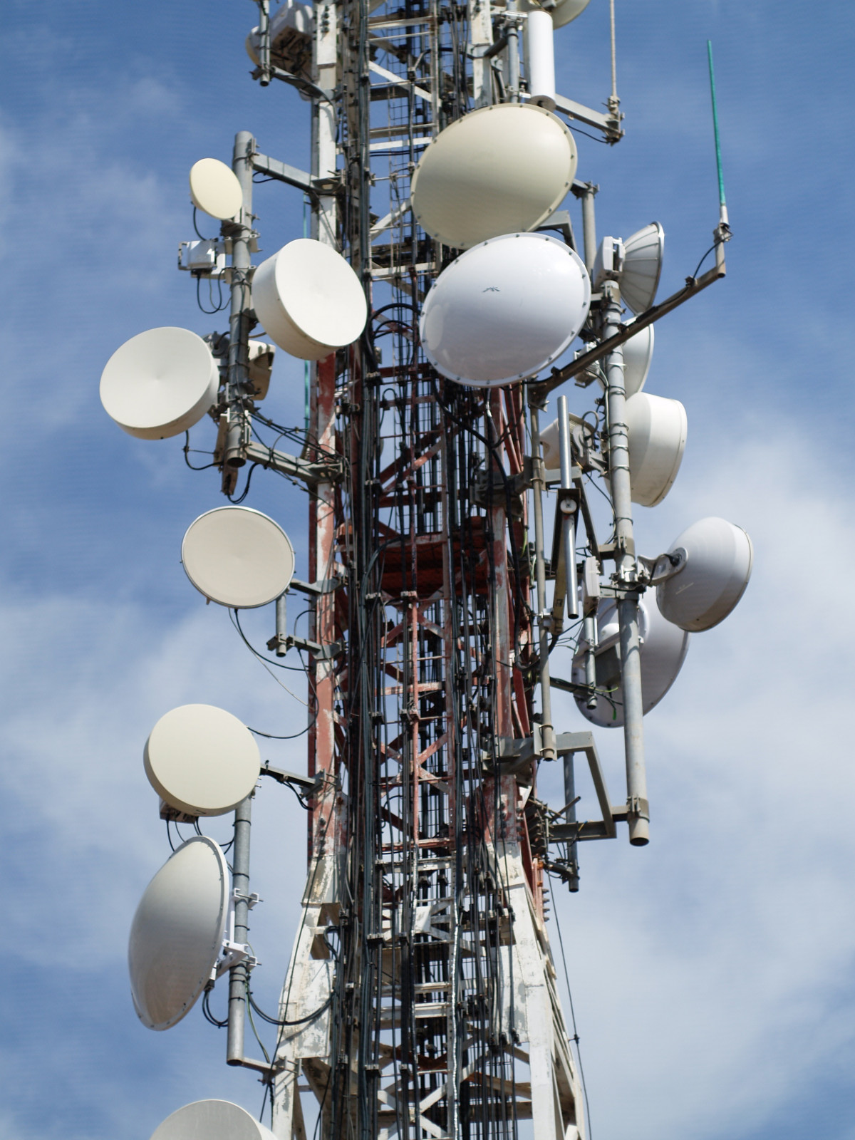
The day stands as a reminder for India’s achievements in science and technology and is celebrated to honour leaders in space travel, defense, healthcare, agriculture and more. It serves to recognise the contributions of Indian scientists, engineers, and technologists to their respective fields and the country’s development. Involving the youth in appreciating such talents will help build inspiration and motivation to pursue excellence in similar fields.
Celebration
To mark the occasion, several events, seminars, conferences, and exhibitions are conducted to demonstrate India's technological prowess. The day shines light on the importance of investment in technology and provides a platform for innovators to exchange ideas and work on collaborations.
Prime Minister Narendra Modi on Thursday hailed the 1998 nuclear tests in Pokhran as one of the most glorious days in India's history, and asserted that technology for the country is not about showing its dominance but a tool to speed up its development.
Addressing an event on the National Technology Day in Delhi, the PM said the country is moving in every direction which is needed to be a tech leader.
The programme also marked the commencement of 25th year celebrations of National Technology Day, which will be held from May 11-14.

Slide 7
National Technology Day: History and significance
As part of “Operation Shakti”, India successfully conducted the Nuclear Missile Test at the Indian Army's Pokhran range on May 11, 1998. The successful testing in Pokhran made India only the sixth country in the world to possess nuclear weapons.
The government under Prime Minister Atal Bihari Vajpayee directed the Council for Technology to conduct the National Technology Day celebrations on May 11 from next year. Since then, the event has been an annual affair aimed at highliting India's quest for scientific inquiry, technological creativity and innovation.
The central government also uses the platform to announce the winners for Rashtriya Vigyan Purashkar, or National Science Awards. Meanwhile, to mark India's technological prowress, several seminars, conferences and exhibitions are conducted across the country
Beyond commemorating past achievements, National Technology Day serves as a beacon for the nation's future. Its primary objective is to instil a passion for science and technology among the younger generation, encouraging them to pursue careers in fields such as engineering, mathematics, and innovation. By fostering a scientific mindset from an early age, the hope is to cultivate a pool of talented individuals who can contribute to India's technological growth.
Moreover, the day emphasises collaboration between various stakeholders — academia, industry, and government. This collaboration is crucial for addressing contemporary challenges through technological innovation. By bringing together experts from different sectors, National Technology Day facilitates discussions on emerging trends and encourages the exchange of ideas that can lead to groundbreaking solutions.

